Slide 1


Neural Network Models for Object Recognition
Hamid Abdul

Slide 2
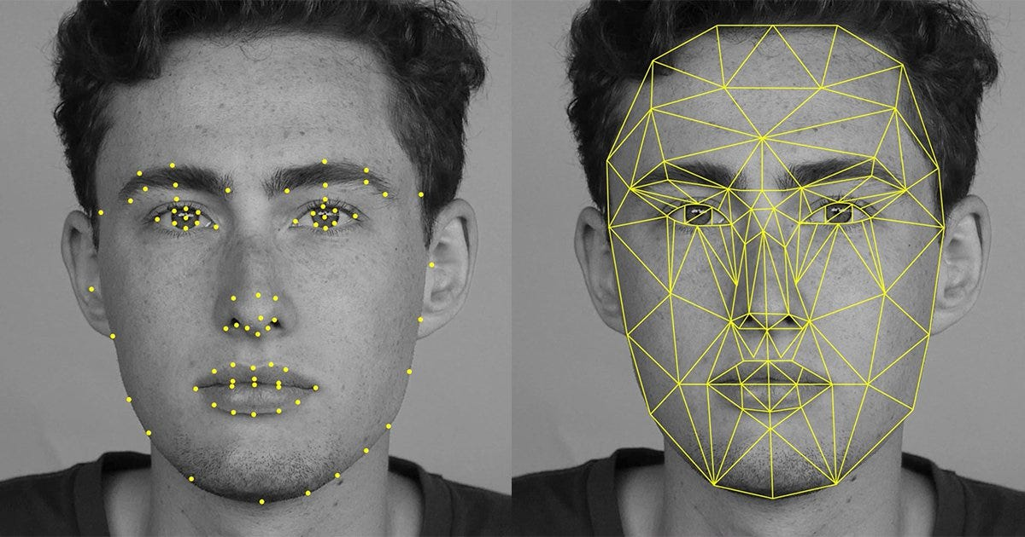
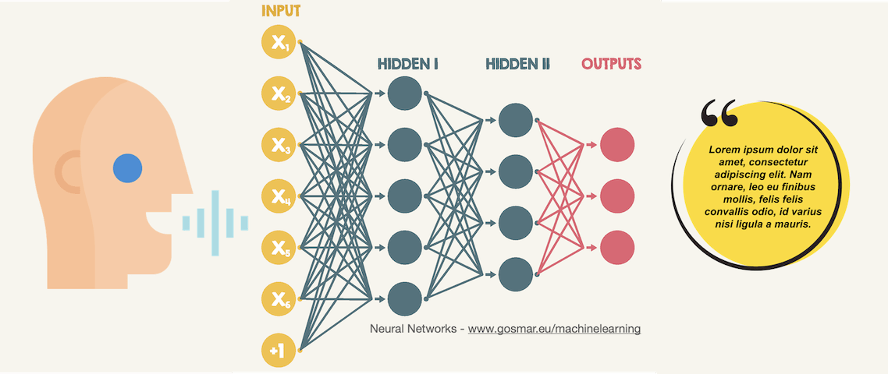
Introduction
Facial Recognition using Pipeline: Murrray, C. Medium
Neural networks and Speech recognition: Source: gosmar.eu

Slide 3
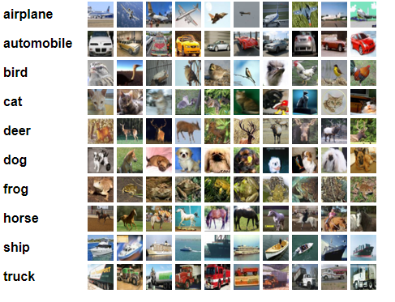
CIFAR-10 Dataset
Widely used collection of images to train machine learning and computer vision algorithms.
The CIFAR-10 dataset was created by Alex Krizhevsky, Vinod Nair, and Geoffrey Hinton from the University of Toronto.
Contains 60,000 32 x 32 colour images in 10 different classes. Divided into 50,000 training images and 10,000 test images.
CIFAR-10. Source: University of Toronto

Slide 4

Convolutional Neural Network (CNN)
CNN Architecture: Source: Balaji, S. Medium

Slide 5
Objective
Develop and train a Convolutional Neural Network (CNN) using the designated training dataset, alongside a validation set, to accurately predict image classification on the test dataset.
Advantages of CNN
CNN can automatically and adaptively learn spatial hierarchies of features from images, which is beneficial for capturing the essential characteristics of images for classification (Huang, 2022).
CNN has been applied successfully across various domains including medical imaging, face recognition, and satellite image classification indicating their versatility (Ruofan, 2022)..
Disadvantages of CNN
CNNs require large datasets for training to avoid overfitting, which can be limiting in domains where data is scarce or difficult to acquire (Mikolajczyk & Grochowski, 2018).
CNNs can be computationally intensive, requiring significant hardware resources for training (Schneider et al. 2021).

Slide 6
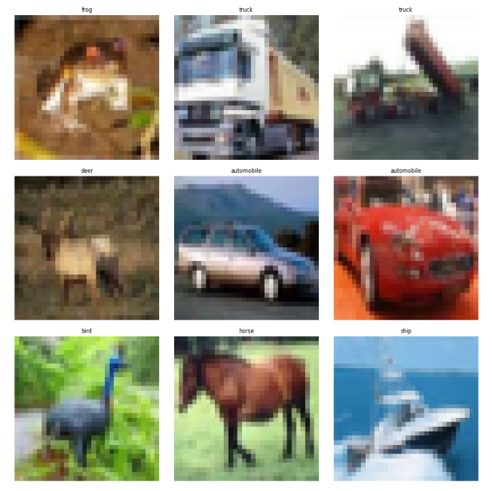
Examining the data
The shape of train (X_train): (50000, 32, 32, 3)
The shape of train label (y_train): (50000, 1)
The shape of test (X_test): (10000, 32, 32, 3)
The shape of test_label(y_test): (10000, 1)

Slide 7
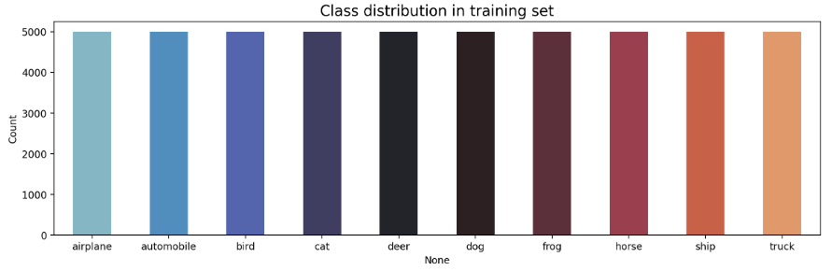
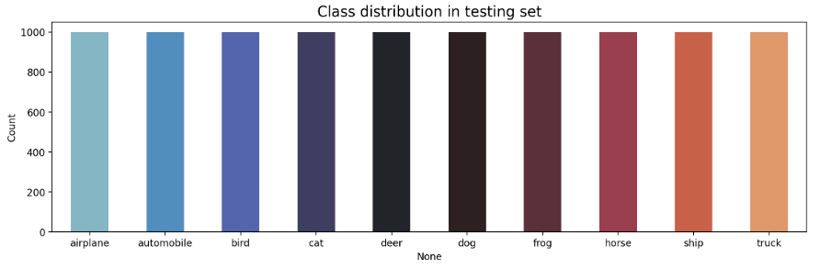
Distribution of data and data preparation.
10 classes, equally distributed in training and test set.
Data preparation
Normalise the data.
Change labels of y_train and y_test into categorical data.

Slide 8
Validation Set
Splitting original training data into a new training and validation set, the validation set will be 20% of training data.
Using train_test_split from sklearn to split data.
The validation set will be 10,000 and training data will be 40,000.
New training data set (80%)
Training dataset
Validation Set (20%)

Slide 9
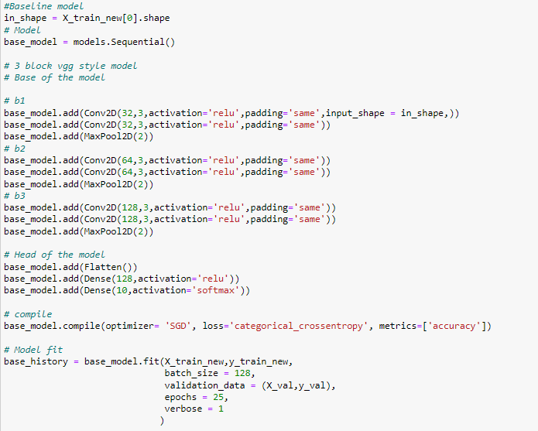
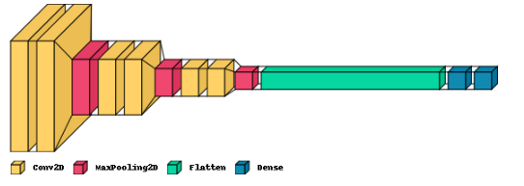
CNN – Baseline Model

Slide 10
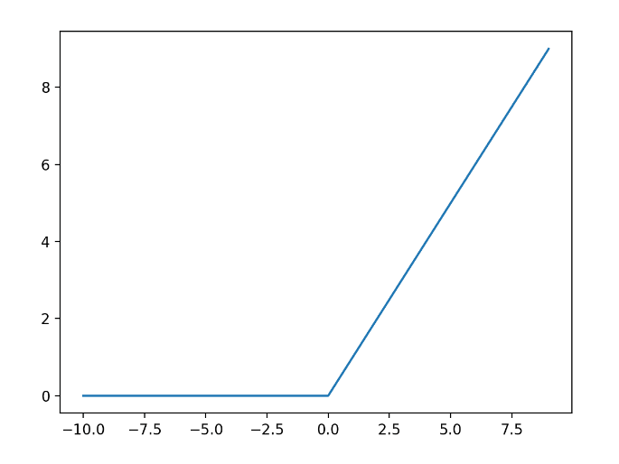
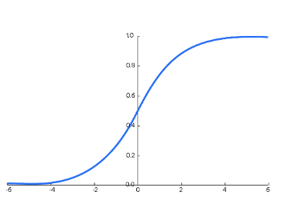
Activation Function
ReLU – Rectified Linear Unit.
For any given input, it outputs the value directly if it is positive, if the input is negative, the output is zero.
Computationally efficient, helps model train faster and achieve better performance.
Softmax
Transforms a vector of values into a vector of probabilities. The sum of these scores is one, which makes it useful when the output needs to be a probability distribution.
Provides meaningful interpretation of the models prediction making it clear which class is most probable.
Line Plot of ReLU inputs Source: Machine Learning Mastery.com
Softmax Function: Source: botpenguin.com

Slide 11
Loss Function and Optimiser
Loss Function – Categorical Cross Entropy
Gold standard for multi-class classification, measures the distance between the model’s predicted probability distribution and the true distribution.
Optimiser – Stochastic Gradient Descent
A form of gradient descent where it operates on randomly selected subsets instead of performing computations on the full dataset.
25 Epochs
Taking into consideration risk of overfitting and computational intensity.

Slide 12
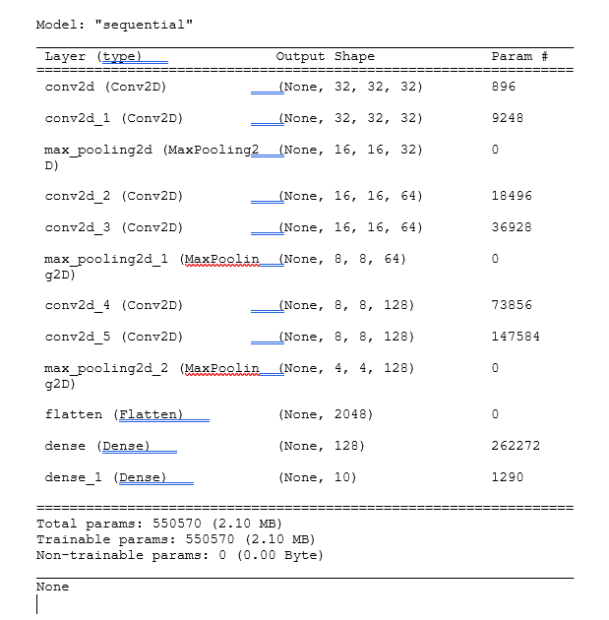
Baseline Model Summary

Slide 13
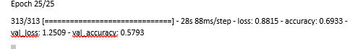
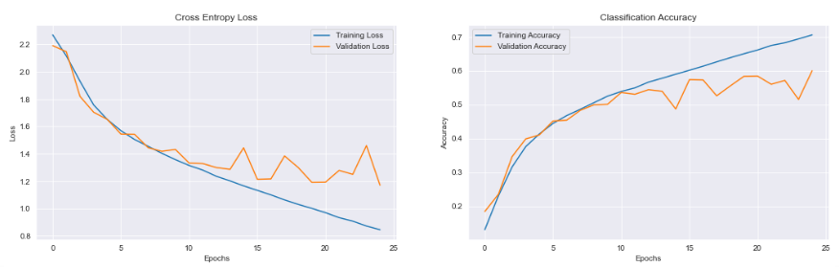
Evaluation of Base Model

Slide 14
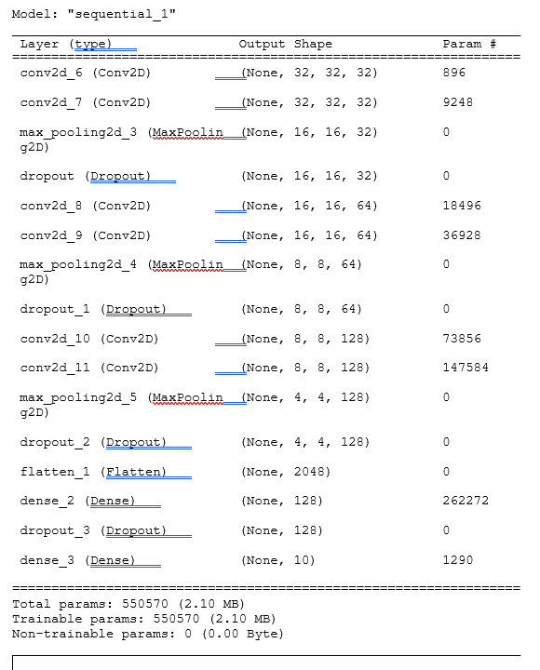
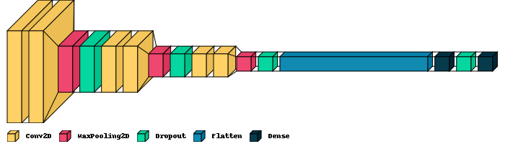
Second Model, adding dropout.

Slide 15
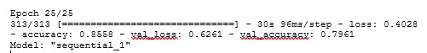
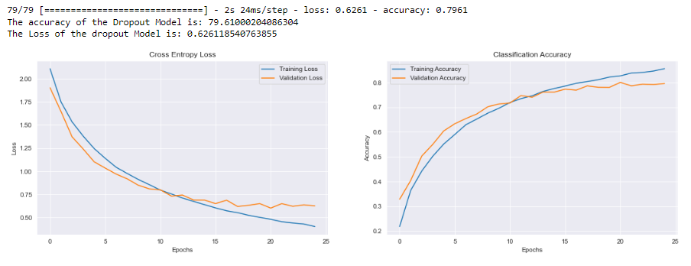
Second Model (cont.)

Slide 16
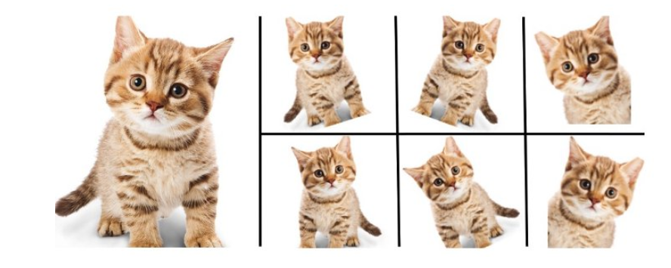
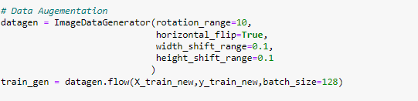
Third Model, adding data augmentation and dropout
Kitten Data Augmentation Source: Shinde,Y Medium

Slide 17
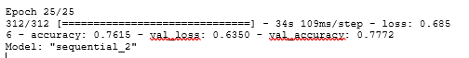
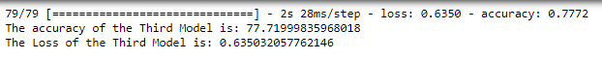
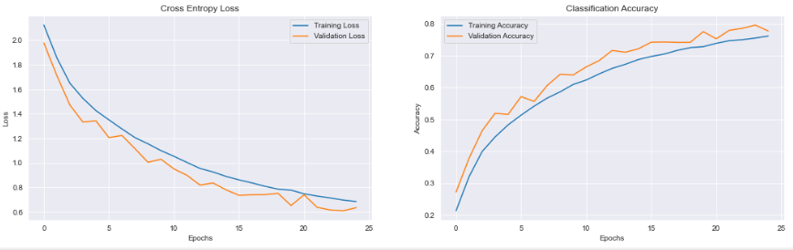
Third Model (cont.)

Slide 18
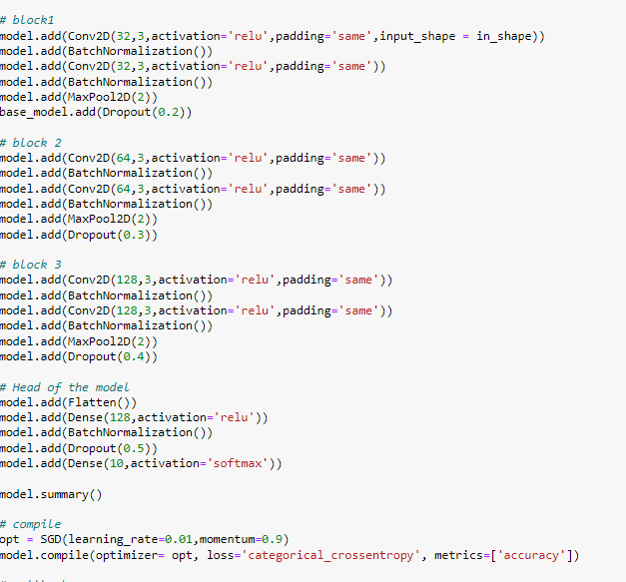
Final Model, adding batch normalisation, data augmentation and dropout.

Slide 19
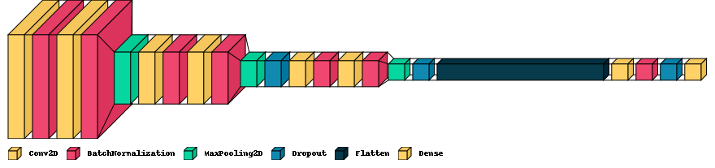
Final Model (cont.)

Slide 20
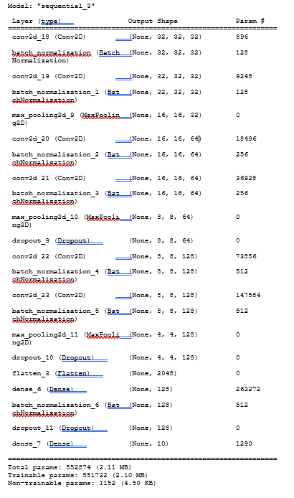
Final Model (cont.)

Slide 21
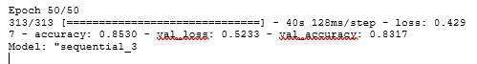
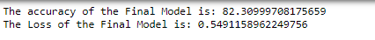
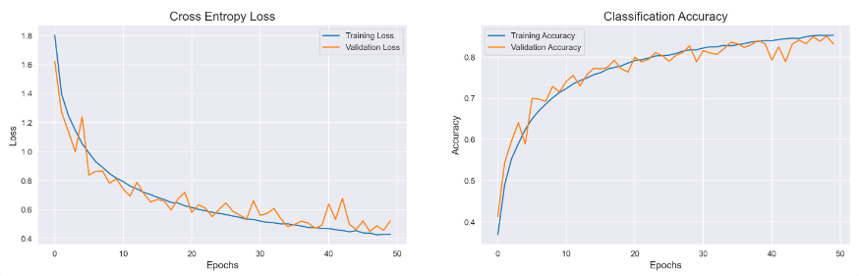
Evaluation of Final Model

Slide 22
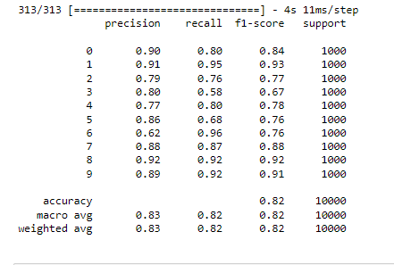
Evaluating model on test data

Slide 23
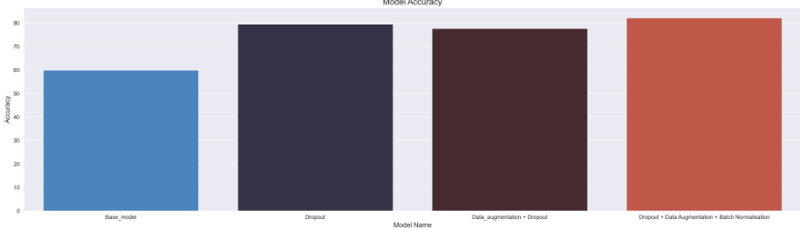
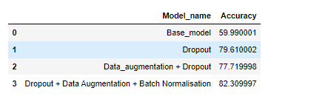
Conclusion

Slide 24
Further work
Further Work
Look into the specific scores of the model, how can we improve cat and dog scores.
Testing the model on datasets beyond CIFAR
Look into how we can incorporate the model into real-world scenarios e.g. automated driving systems

Slide 25
Reflections
Model development – Iterative process of model development, you must experiment with hyperparameters. Sometimes keeping it simple is best. Look at external ways to improve the model (data augmentation).
Importance of performance metrics.
Theoretical understanding lays foundation of understanding, yet practical application often reveals complexity between theory and reality. It does not always align in the ‘black box’.

Slide 26
Reference List
Alzubaidi, L., Zhang, J., Humaidi, A.J., Al-Dujaili, A., Duan, Y., Al-Shamma, O., Santamaria, J., Fadhel, M.A., Al-Amidie, M., Farham, L. (2021) Review of deep learning: concepts, CNN architectures, challenges, applications, future directions. Journal of Big Data (53). DOI: https://doi.org/10.1186/s40537-021-00444-8
Agarap, A.F. Deep Learning using Rectified Linear Units (ReLU) Reprint. DOI: https://doi.org/10.48550/arXiv.1803.08375
Cabanilla, K.I.M., Mohammad, R.Z. & Lope, J.E.C. (2024) Neural networks with ReLU powers need less depth. Neural Networks 172. DOI: https://doi.org/10.1016/j.neunet.2023.12.027
Balaji, S. (2020) Binary Image Classifier CNN using TensorFlow. Available from: https://medium.com/techiepedia/binary-image-classifier-cnn-using-tensorflow-a3f5d6746697 [Accessed 3rd Feb 2024]
Bot Penguin (2024) Softmax Function. Available from: https://botpenguin.com/glossary/softmax-function [Accessed 4th February 2024].
Bjorck, J., Gomes, C., Selman, B. & Weinberger, K.Q. (2018) Understanding Batch Normalization. Advances in neural information processing systems 31. DOI: https://doi.org/10.48550/arXiv.1806.02375
The CIFAR-10 dataset (2009) Available from: https://www.cs.toronto.edu/~kriz/cifar.html [Accessed 3rd January 2024]
Gosmar.eu (2020) Neural networks and speech recognition. Available from: https://www.gosmar.eu/machinelearning/2020/05/25/neural-networks-and-speech-recognition/. [Accessed 12th February 2024].
Hassan, E., Shams, M.Y., Hikal, N.A. & Elmougy, S. (2022) The effect of choosing optimiser algorithms to improve computer vision tasks: a comparative study. Multimedia Tools and Application. 82: 16591-16633. DOI: https://doi.org/10.1007/s11042-022-13820-0
Huang, K. (2022). “Image Classification Using the Method of Convolutional Neural Networks”. 2022 IEEE Conference on Telecommunications, Optics and Computer Science (TOCS). Dalian, China, 11-12th December 2022 pp 827-832. DOI: 10.1109/TOCS56154.2022.10016070

Slide 27
Reference List (cont.)
Kerkhof, M., Wu, L., Perin, G., & Picek, S. (2023) No (good) loss no gain: systematic evaluation of loss functions in deep learning- based side – channel analysis. Journal of Cryptographic Engineering. 13: 311-324. DOI: https://doi.org/10.1007/s13389-023-00320-6
Lu, Yongtao, Huo, Y., Yang, Z., Niu, Zhao, M., Bosiakov & Lei, L. (2022) Influence of the parameters of the convolutional neural network model in predicting the effective compressive modulus of porous structure. Frontiers in Bioengineering and Biotechnology. DOI:10.3389/fbioe.2022.985688
Agarap, A.F. (2018) Deep Learning Mastery (2020) A Gentle Introcution to the Rectified Linear Unit (ReLU). DOI: https://machinelearningmastery.com/rectified-linear-activation-function-for-deep-learning-neural-networks/ [Accessed 4th February 2024].
Mikolajczyk, A. & Grochowski, M. (2018) “Data Augmentation for Improving Deep Learning in Image Classification Problem”.2018 IEEE International Disciplinary PhD Workshop. Katowice, Poland, 09-12 May 2018. DOI: 10.1109/IIPHDW.2018.8388338
Mo, R. (2022). A Survey of Image Classification Algorithms based on CNN. Highlights in Science, Engineering and Technology. Volume 15. DOI: https://doi.org/10.54097/hset.v15i.2222
Murray, C. (2017) Building a Facial Recognition Pipeline with Deep Learning in Tensorflow. Available from: https://medium.com/hackernoon/building-a-facial-recognition-pipeline-with-deep-learning-in-tensorflow-66e7645015b8. [Accessed 12th February 2024].
Nwankpa, C.E., Ijomah, W., Gachagan, W. & Marshall S. (2020) Activation Functions: comparison of trends in practice and research for deep learning. 2nd International Conference on Computational Science and Technology 17-19th December. Jamshoro: Pakistan.
Schneider, M., Amann, R. & Mitsantisuk. C. (2021) “Waste object classification with AI on the edge accelerators”. 2021 IEEE International Conference on Mechatronics. Kashiwa, Japan, 07-09 March 2021 pp 1-6. DOI: 10.1109/ICM46511.2021.9385682.

Slide 28
Reference List (cont.)
Shinde, Y. (2022) Custom Data Augmentation using Keras Image Data Generator. Available from: https://medium.com/geekculture/custom-data-augmentation-using-keras-imagedatagenerator-7cfd58e54171 [Accessed 4th February].
Simonyan, K. & Zisserman, A. (2014) Very Deep Convolutional Networks for Large-Scale Image Recognition. International Conference on Learning Representations San Diego. May 7-9th. Oxford: University of Oxford.
Srivastava, N., Hinton, G., Krizhevsky, A., Sutskever, I., Salakhutdinov, R. (2014) Dropout: A Simple way to Prevent Neural Networks from Overfitting. Journal of Machine Learning. 15(56): 1929-1958.
Yamashita, R., Nishio, M., Kinh Dian Do, R. & Togashi, K. (2018) Convolutional neural networks: an overview and application in radiology. Insights into Imaging. 9: 611-629. DOI: https://doi.org/10.1007/s13244-018-0639-9
Ying, X. (2019) An Overview of Overfitting and its Solutions. Journal of Physics Conference Series. 1168. DOI: doi:10.1088/1742-6596/1168/2/022022
Zhao, L. & Zhang, Z. (2024) A improved pooling method for convolutional neural networks. Scientific Reports. 14. DOI:https://doi.org/10.1038/s41598-024-51258-6
Zhang, S., Ku, B & Ko, H. (2021) Analysis of normalization effect for earthquake events classification. The Journal of the Acoustical Society of Korea. 40: 130-138. DOI: https://doi.org/10.7776/ASK.2021.40.2.130.

